Slide 1

Design of Algorithms Programming Project II - Routing Algorithm for Ocean Shipping and Urban Deliveries
Made by group g03_2 :
Mansur mustafin - 202102355
José Nuno Barbosa Quintas – 202108712
Francisco gonçalves de sousa - 202108838
May 4 2023

Slide 2
Table of Content
Class Diagram
Dataset Reading
Graph description
List of features and algorithms
Comparison of Algorithms
User interface
Main difficulties
Effort of each member

Slide 3
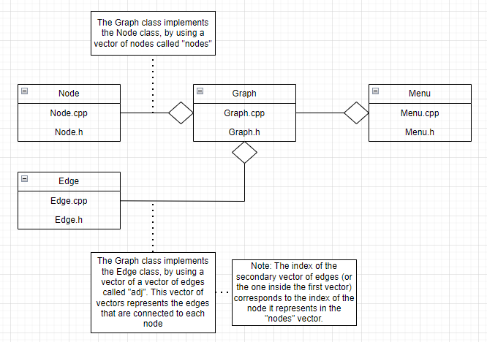
Class Diagram

Slide 4
Dataset Reading
When an object of the class Graph is created, two string containing the names of the files from which the data will be loaded are passed to the Graph Constructor.
The Graph has a vector of Nodes called “nodes”, where the function “input_vertex” inserts the objects of the class Node it creates when the Graph constructor is called.
The Graph also has a vector of vectors of Edges called “adj”, where the function “input_edge” inserts the objects of the class Edge it creates when the Graph constructor is called.
Note: The index of the “inside” vector in “adj” corresponds to the index of the node in “nodes” whose edges are in the vector.

Slide 5
Graph description
This is how the Graph has been organized:
Objects of the class Node are the vertices of the Graph and stored in a vector named “nodes”
Objects of the class Edge are the edges of the Graph and stored in a vector of vectors named “adj”

Slide 6
List of features and algorithms
Backtracking Algorithm:
Time Complexity: O(N!), where N is the number of Nodes in the Graph being analysed
Ant Colony Optimization Algorithm:
Time Complexity: O(max_iter * num_ants * n²), where max_iter is the maximum number of iterations possible, num_ants is the number of ants given and n is the size of the distance matrix. All of these variables are passed to the ACO() function.
Simulated Annealing Algorithm:
Time Complexity: O(N * A), where N is the size of the permutation used and A is the number of adjacent nodes of each node of the permutation

Slide 7
List of features and algorithms
Cristofides Algorithm:
Time Complexity: O(E * log(V) + N³), where E is the number of edges in the Graph, V is the number of vertices (or nodes) and N is the size of the path
Triangular Approximation and…
Triangular Approximation using a Distance Matrix:
Used algorithms/functions:
Prim’s Algorithm: Time complexity: O(E * log(V)), where E is the number of Edges and V is the number of vertices (or nodes) of the Graph being analysed
Preorder Walk: Time complexity: O(E * log(E) + N * E), where E is the number of edges of the Minimum Spanning Tree (MST) and N is the number of adjacent nodes of each node.

Slide 8
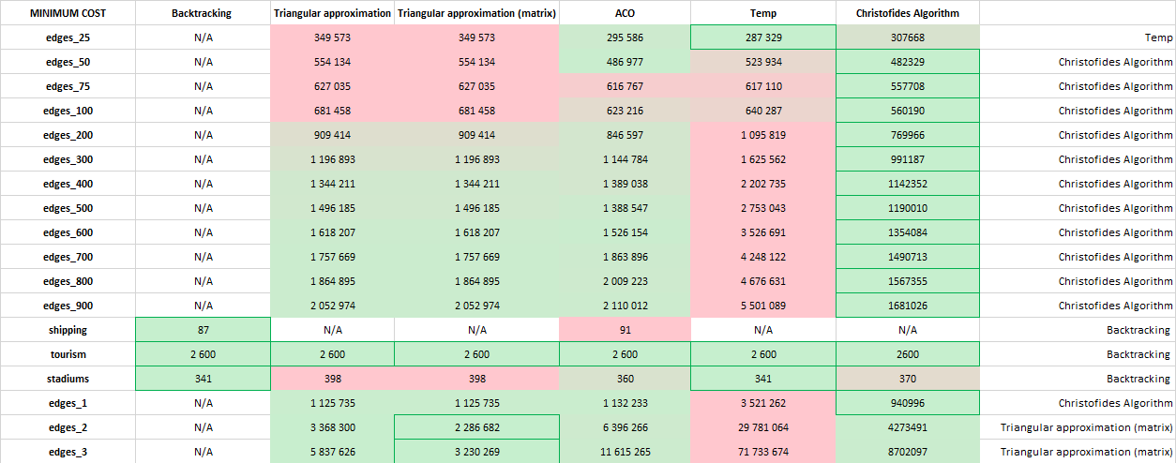
Comparison of Algorithms and their Minimum Cost

Slide 9
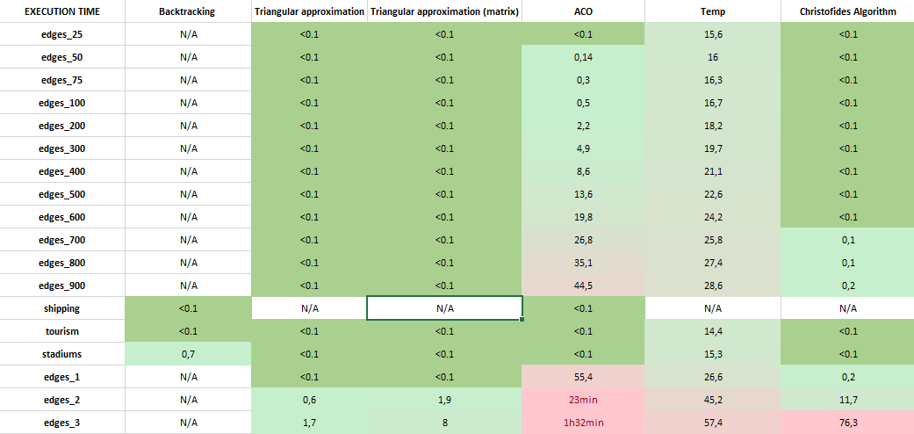
Comparison of Algorithms and their Execution Times

Slide 10
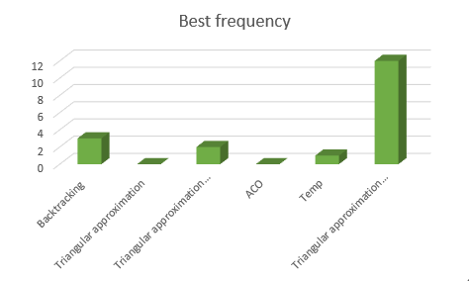
Comparison of Algorithms (Conclusion)
Algorithm | Number of times this algorithm is the best option
Backtracking | 3
Triangular Approximation | 0
Triangular Approximation with Distance Matrix | 2
ACO | 0
Temp | 1
Triangular Approximation using Cristofides | 12

Slide 11
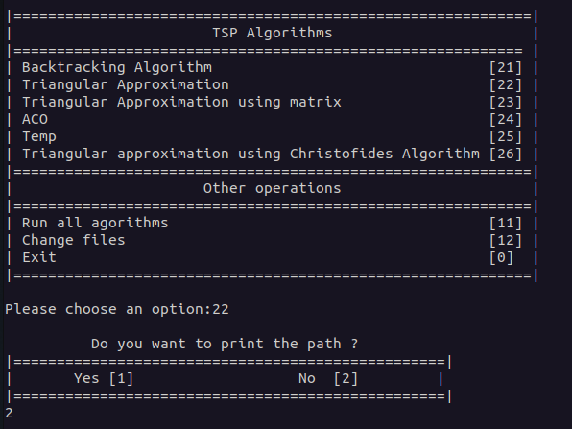
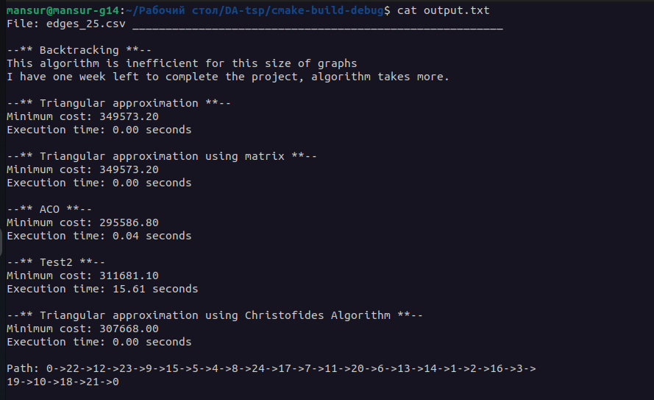
User interface

Slide 12
Main difficulties
Our main difficulties were the following:
Analyzing the input arguments in ACO and Annealing algorithms.
Debug of program.

Slide 13
Effort of each member
Mansur Mustafin – Graph Algorithms, Main Functions
Francisco Gonçalves de Sousa – Graph Construction, User Interface, Menu
José Nuno Barbosa Quintas – Graph Structure and Population, Documentation, Presentation.

